Slide 1
AUTOMOBILES
Dimitris Milakis, Transport Institute, Delft University of Technology
Envisioning Automated Vehicles within the Built Environment: 2020, 2035, 2050
Ancillary Workshop to the TRB Automated Vehicles Symposium 2014, Friday, 18 July

Slide 2
AUTOMOBILES
Dimitris Milakis, Transport Institute, Delft University of Technology
2014 CURRENTLY
AVAILABLE TECHNOLOGY
NHTSA Level 2: Limited automation (available on some new vehicles)
Envisioning Automated Vehicles within the Built Environment: 2020, 2035, 2050
Ancillary Workshop to the TRB Automated Vehicles Symposium 2014, Friday, 18 July

Slide 3
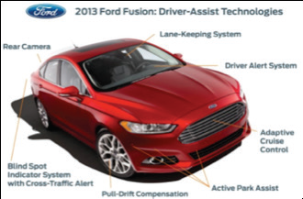
ADAS of 2013 Ford Fusion http://geeknewscentral.com
Envisioning Automated Vehicles within the Built Environment: 2020, 2035, 2050
Ancillary Workshop to the TRB Automated Vehicles Symposium 2014, Friday, 18 July

Slide 4
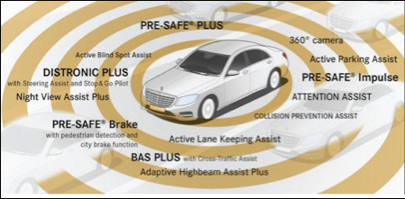
2014 Mercedes-Benz S-class
http://www5.mercedes-benz.com/en/innovation
Envisioning Automated Vehicles within the Built Environment: 2020, 2035, 2050
Ancillary Workshop to the TRB Automated Vehicles Symposium 2014, Friday, 18 July

Slide 5
2020
NHTSA Level 3: Limited Self-Driving Automation
(The Google car is an example of this level of automation)
Envisioning Automated Vehicles within the Built Environment: 2020, 2035, 2050
Ancillary Workshop to the TRB Automated Vehicles Symposium 2014, Friday, 18 July

Slide 6
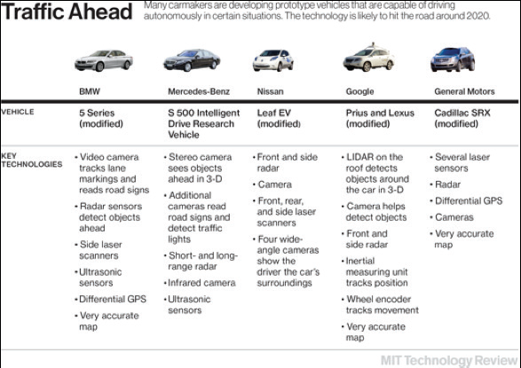
Key (limited) self-driving technologies by four major carmakers and Google.
Source: Knight (2013)
Envisioning Automated Vehicles within the Built Environment: 2020, 2035, 2050
Ancillary Workshop to the TRB Automated Vehicles Symposium 2014, Friday, 18 July

Slide 7
2030
NHTSA Level 4: Full self-driving automation
Envisioning Automated Vehicles within the Built Environment: 2020, 2035, 2050
Ancillary Workshop to the TRB Automated Vehicles Symposium 2014, Friday, 18 July

Slide 8
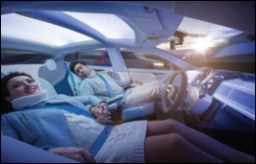
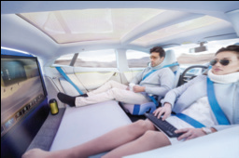
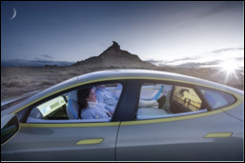
The potential transformations in the interior of a full self-driving car, as demonstrated by the Swiss design firm Rinspeed in the Geneva Motor Show on March 2014. Their concept car ‘Xchange’ was a Tesla model S.
Source: http://www.rinspeed.eu
Envisioning Automated Vehicles within the Built Environment: 2020, 2035, 2050
Ancillary Workshop to the TRB Automated Vehicles Symposium 2014, Friday, 18 July

Slide 9
2050
During the 2050s, nearly all of the vehicles in use are likely to be self-driving cars, with full self-driving automation being a standard feature on most new vehicles
(Litman, 2013; Juliussen & Carlson, 2014).
Envisioning Automated Vehicles within the Built Environment: 2020, 2035, 2050
Ancillary Workshop to the TRB Automated Vehicles Symposium 2014, Friday, 18 July

Slide 10
GLOSSARY
Adaptive cruise control: a system that monitors distances to
adjacent vehicles in the same lane, adjusting the speed with the flow of traffic.
Lane keeping assist: a system that monitors the vehicle’s
position in the lane, and either warns the driver
when the vehicle is leaving its lane, or, less commonly,
takes corrective actions
Parking assist: a system that assists the driver in the task of parallel
parking.
Collision avoidance (or prevention) assist: an automobile safety
system designed to reduce the severity of an accident. It uses radar and sometimes laser and camera sensors to detect an imminent crash.
Envisioning Automated Vehicles within the Built Environment: 2020, 2035, 2050
Ancillary Workshop to the TRB Automated Vehicles Symposium 2014, Friday, 18 July

Slide 11
GLOSSARY
Adaptive cruise control: a system that monitors distances to
adjacent vehicles in the same lane, adjusting the speed with the flow of traffic.
Lane keeping assist: a system that monitors the vehicle’s position in
the lane, and either warns the driver when the vehicle is leaving its lane, or, less commonly, takes corrective actions.
Parking assist: a system that assists the driver in the task of parallel parking.
Collision avoidance (or prevention) assist: an automobile safety system designed to reduce the severity of an accident. It uses radar and sometimes laser and camera sensors to detect an imminent crash.
Envisioning Automated Vehicles within the Built Environment: 2020, 2035, 2050
Ancillary Workshop to the TRB Automated Vehicles Symposium 2014, Friday, 18 July

Slide 12
GLOSSARY
LIDAR (Light Detection and Ranging): a remote sensing technology
that measures and maps the distance to targets, as well as other property characteristics of objects in its path. LIDAR allows the vehicle to generate a detailed 3D map of its environment. The LIDAR system used in the Google car cost $70,000.
Platoon: a group of vehicles that can travel very closely together, safely at high speed. Each vehicle communicates with the other vehicles in the platoon. There is a lead vehicle that controls the speed and direction, and all following vehicles respond to the lead vehicle’s movement.
Envisioning Automated Vehicles within the Built Environment: 2020, 2035, 2050
Ancillary Workshop to the TRB Automated Vehicles Symposium 2014, Friday, 18 July

Slide 13
GLOSSARY
Vehicle-to-Vehicle (V2V) communications: the dynamic wireless exchange of data between nearby vehicles. Dedicated Short- Range Communication (DSRC) is currently the wireless medium for V2V communications.
Vehicle-to-Infrastructure (V2I) communications: the wireless exchange of critical safety and operational data between vehicles and infrastructure. Dedicated Short-Range Communication (DSRC) is currently the wireless medium for V2I communications. DSRC works in 5.9GHz band with bandwidth of 75 MHz and approximate range of 1000 m
Envisioning Automated Vehicles within the Built Environment: 2020, 2035, 2050
Ancillary Workshop to the TRB Automated Vehicles Symposium 2014, Friday, 18 July

