Slide 1
Complete Street for 2030 & 2050

Slide 2
Complete Streets 2030

Slide 3
Complete Streets 2030

Slide 4
Complete Streets 2030

Slide 5
Complete Streets 2030

Slide 6
Complete Streets 2030

Slide 7
Complete Streets 2030

Slide 8
Complete Streets 2050

Slide 9
Complete Streets 2050

Slide 10
Complete Streets 2050

Slide 11
Complete Streets 2050

Slide 12
Complete Streets 2050

Slide 13
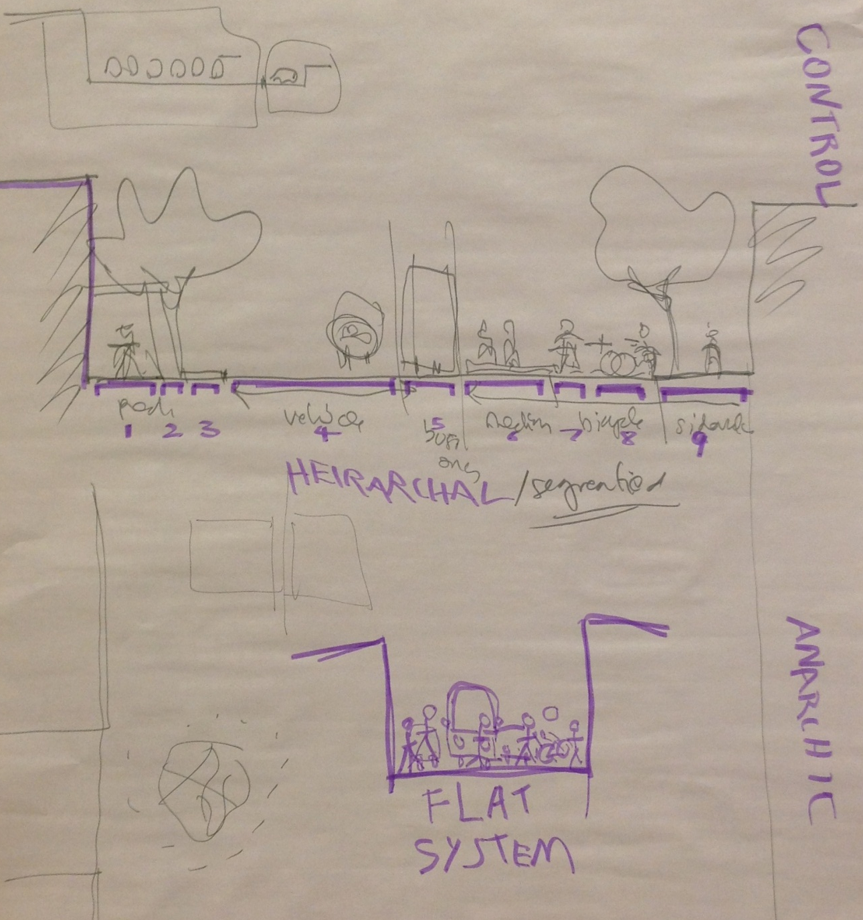
Complete Streets 2050

Slide 14
Complete Streets 2050

