Slide 1
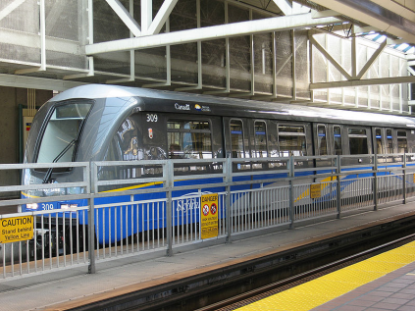
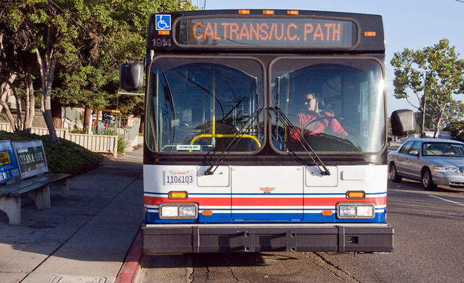
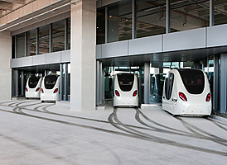
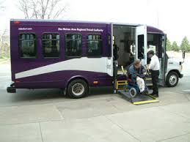
Roadway Scene
Source: Wikipedia.org, 2009 System: Vancouver Skytrain | Source: Wired.com 2008 System: PATH Experimental Bus | Source: Time Magazine, 2011 System: Masdar City PRT | Source: Des Moines Area Regional Transit, 2014 System: Paratransit
Reuben Juster, EIT
Faculty Research Assistant
University of Maryland College Park
CATTworks

Slide 2
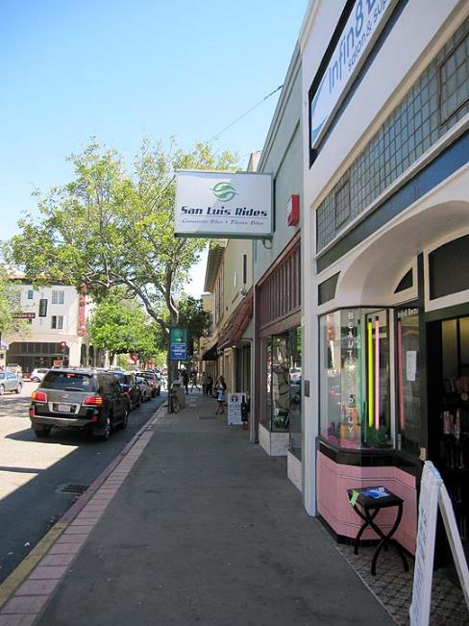
Main Street
Typical main street in medium city
Parallel parking
Sidewalks
Small painted median
Frequent bus service

Slide 3
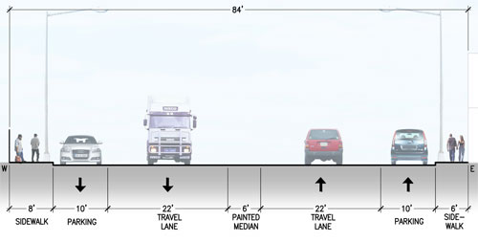
Main Street Cross Section (Now)

Slide 4
Main Street Cross Section (Future)
Higher precision, narrower lanes
Guideways?

Slide 5
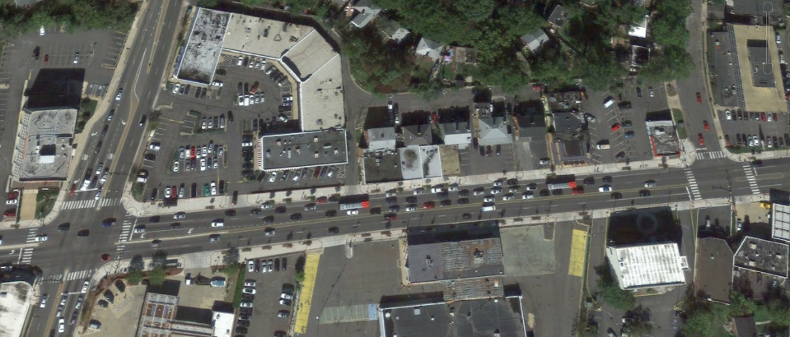
Main Street Block (Now)

Slide 6
Main Street Block (Future)
Smaller parking spaces?
Smaller turn bays?
More drop off/ pick up zones?

Slide 7
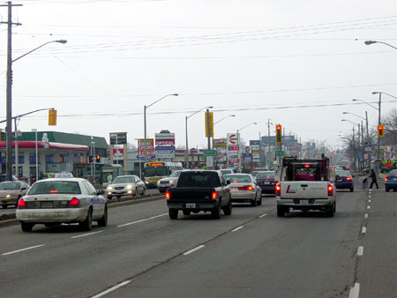
Arterial
MOBILITY accessibility
Big box stores
Frontage roads
Pedestrians?
Ugh, buses

Slide 8
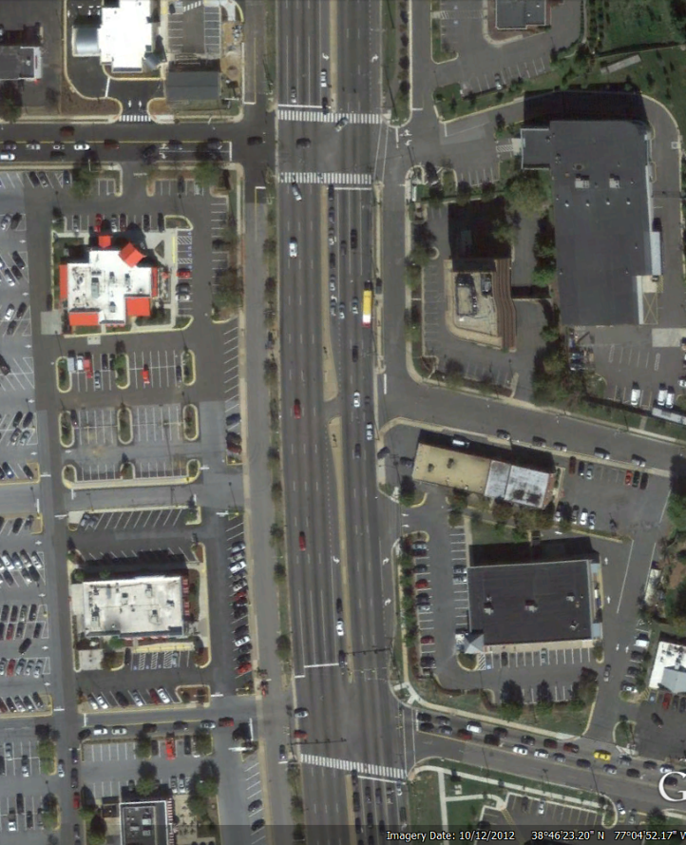
Arterial Blocks
Now
Future

Slide 9
Thank you!
RMJcar@umd.edu
W: (301) 314-0426
M: (310) 597-2300
http://www.advancedtransit.org/
http://www.catt.umd.edu/

