Slide 1
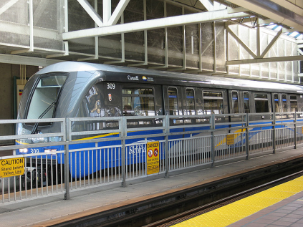
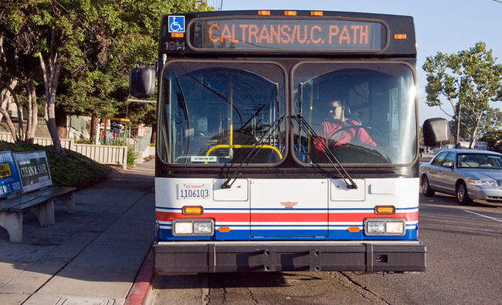
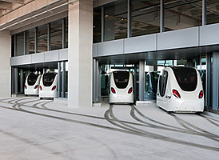
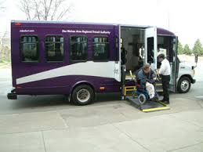
Transit Notecard
Source: Wikipedia.org, 2009 System: Vancouver Skytrain | Source: Wired.com 2008 System: PATH Experimental Bus | Source: Time Magazine, 2011 System: Masdar City PRT | Source: Des Moines Area Regional Transit, 2014 System: Paratransit
Reuben Juster, EIT
Faculty Research Assistant
University of Maryland College Park
CATTworks

Slide 2
Warning!

Slide 3
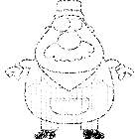
Transit Levels of Automation
Year
2014
2020
2035
2050
Guideway/ Level of Segregation
Level of Automation

Slide 4
Transit Pathways
Source: Wikipedia.org, 2009 System: Vancouver Skytrain | Source: Wired.com 2008 System: PATH Experimental Bus | Source: Time Magazine, 2011 System: Masdar City PRT | Source: Des Moines Area Regional Transit, 2014 System: Paratransit
Reuben Juster, EIT
Faculty Research Assistant
University of Maryland College Park
CATTworks

Slide 5
Warning!

Slide 6
7
8
2050
9
13
6
3
2035
5
None Level of Automation Full
12
2
2020
4
11
10
2014
1
Full Level of Segregation None
Bus
Pod Car
Para-transit
Train
Numbers is shapes refer to number icons in narrative {1}, {2}…

Slide 7
Thank you!
RMJcar@umd.edu
W: (301) 314-0426
M: (310) 597-2300
http://www.advancedtransit.org/
http://www.catt.umd.edu/

